Slide 1
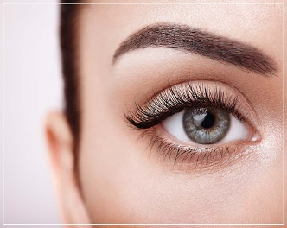
Eye Lids
Gate of the orbit
Dr. Fareed Warid
Consultant Ophthalmologist/Vitreoretinal Surgeon

Slide 2
OLD SAYING
The eyes are the window of the mind
The face is a picture of the mind as the eyes are its interpreter.

Slide 3
Questions
What is the structure of the eyelid?
What is the function of the eyelid?

Slide 4
Functions
Protect the globe
    Prevent foreign body from entering the eye
    Distribute tear film onto the surface of the cornea
    Diminish the stimulus of strong light to the globe
Maintain the cosmetic appearance
Facial Expression

Slide 5
Embryology of eyelids
Derived from surface ectoderm = Skin
Mesodermal = muscles of the lid and tarsal

Slide 6
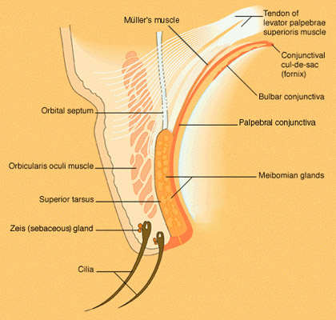
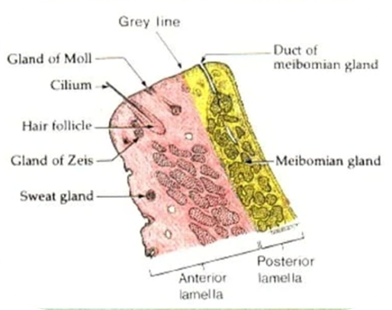
Layers of eyelids
Skin
Subcutaneous areolar tissue
Striated Muscles
  Orbicularis oculi muscle
  Levator palpebral superior muscle
Fibrous layer= Tarsus or Tarsal Plate
Non striated muscular layer,
  Muller’s Muscle
Palpebral Conjunctiva

Slide 7
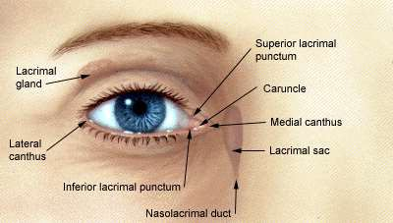
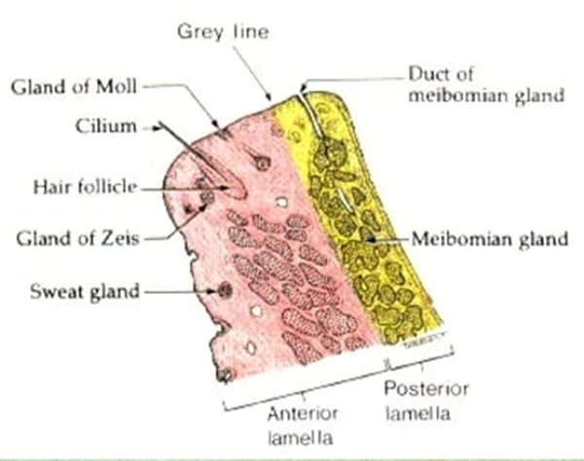
Gross anatomy & Landmarks of eyelids
POSITION OF EYELIDS:
  Upper Lid cover 1/6th of cornea [if it is more =Dropping of Upper Lid = Ptosis]
CANTHI: lids meet each other at medial and lateral canthi
EYELIDS MARGINS, divided by GRAY LINE into
    ANTERIOR ( CUTANEOUS) contain eye lashes
    POSTERIOR ( CONJUNCTIVAL) contain opening of Meibomian gland )

Slide 8
Skin
Thin
High elasticity
Good flexibility
MUSCLES
Orbicularis Oculi Muscle. Nerve?
Levator Palpebrae Superioris. Nerve?
Muller Muscle. Nerve?

Slide 9
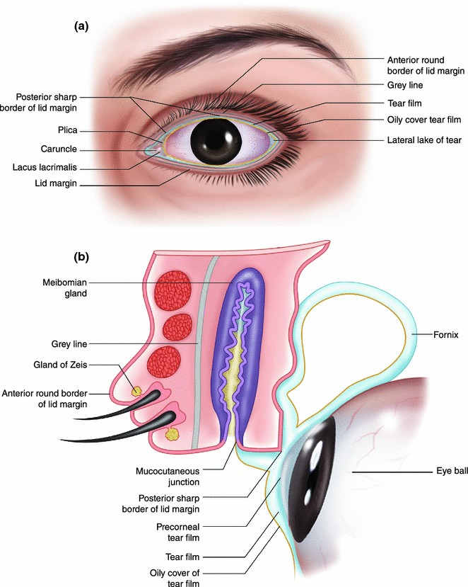
Glands Of Eyelids
Meibomian Glands :
  Modified Sebaceous Glands located in the tarsal plates.
Glands Of Zeis :
  Modified Sebaceous Glands that are associated with lash follicles
Sebaceous Glands :
  located in the caruncle and within eyebrow hairs
Glands Of Moll :
  Modified Sweat Glands

Slide 10
Nerve Supply to Eyelids
Motor :
FACIAL N : Orbicularis oculi muscle= (Lagophthalmos)= Inability To Close Eye Lids
OCULOMOTOR N : Levator Palpebrae Superioris = Ptosis
SYMPATHETIC N : Müller muscle = Horner Syndrome
Sensory :
Ophthalmic & Maxillary divisions of the trigeminal nerve (5th CN) / [ Herpes Zoster Ophthalmicus]

Slide 11
Eye Lids Disorders
Inflammation/Infection
Anatomic deformities
Tumors

Slide 12
Blepharitis
Inflammation of Lid Margin
Bilateral
often misdiagnosed as conjunctivitis
Types
Anterior Blepharitis
Posterior Blepharitis (Meibomitis)

Slide 13
Anterior Blepharitis
Affects the Base of Eyelashes and may be
Infection (Staphylococcal)
Seborrheic

Slide 14
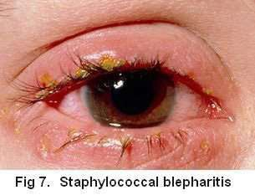
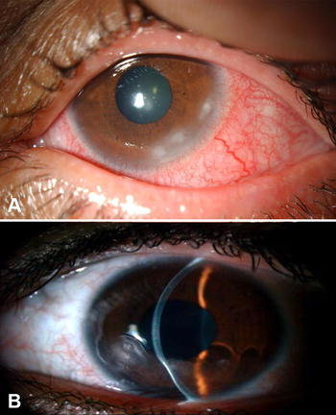
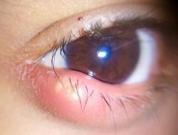
Staphylococcal Blepharitis:
Clinical Manifestations:
Ocular discomfort and irritation
Red Eyes
Yellow Crusts at the Base Of Lashes
Small Ulcers which bleed easily on removal of clusters
Complications:
Mild papillary conjunctivitis
Peripheral corneal infiltrates (more common in atopic dermatitis)
External Hordeolum (STYE)= abscess of lash follicle

Slide 15
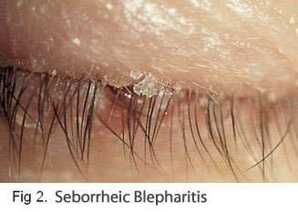
Seborrheic Blepharitis
Usually associated with seborrhea of scalp(dandruff)
Accumulation of white dandruff like scales on lid margin

Slide 16
Treatment
Lid hygiene
Antibiotic
  Topical: Fusidic Acid, or Chloramphenicol
  Oral Azithromycin (500 mg daily for three days)
Topical Steroid for Seborrheic Blepharitis.

Slide 17
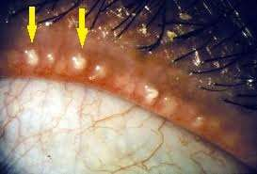
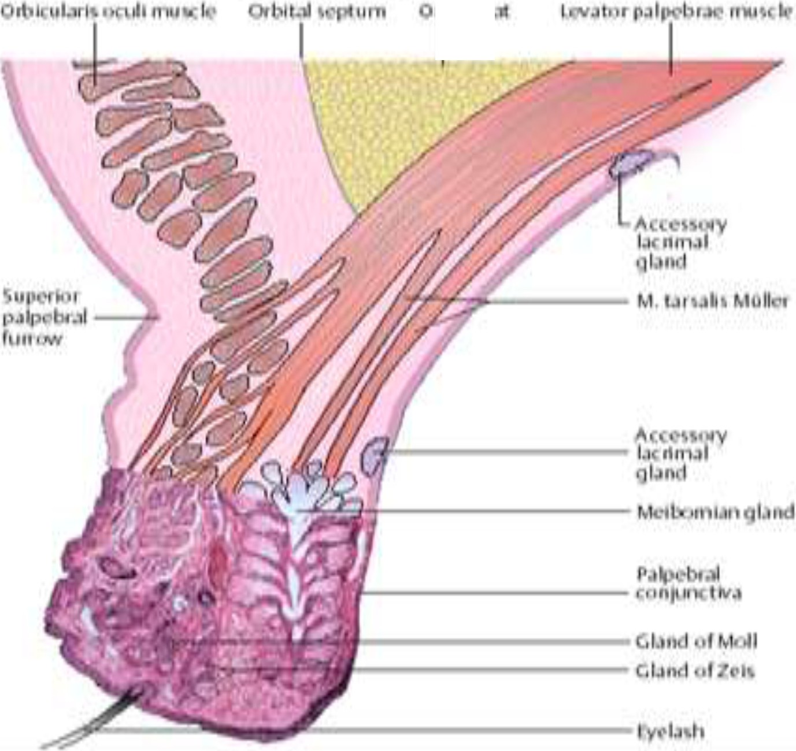
Posterior Blepharitis (Meibomianitis)
Inflammation Meibomian Glands.
Watery eyes
Redness
Burning Sensation in the eyes
Itchy eyelids
Characterized: diffuse thickening of posterior border of lid margin.
Complication : Chalazion ( Internal Hordeolum)

Slide 18

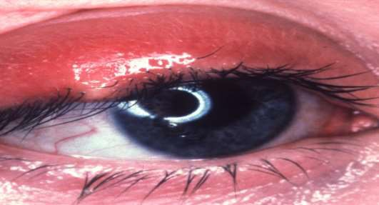
External Hordeolum (STYE)
Infection of Gland Of Zeis Or Moll
Abscess of lash follicle
Organism: staphylococcus
Characteristics
Acute
Pain
Purulent
Swelling, Nodosity
Tender swelling at lid margin
Localized hyperemia , Discharge through skin

Slide 19
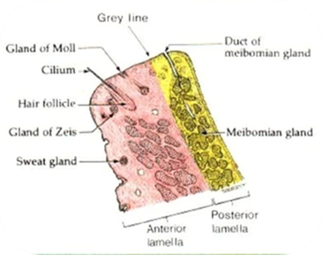
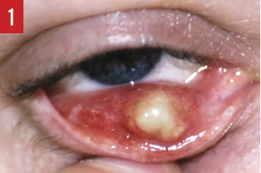
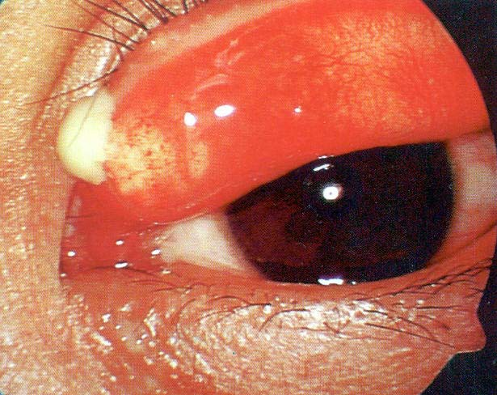
Internal Hordeolum
Staph. abscess of Meibomian Glands
Tender swelling within TARSUS
Discharge through conjunctiva
Localized hyperemia
Abscess rupture into conjunctival sac

Slide 20
Complications
PALPEBRAL (EYE LID) CELLULITIS
THROMBOSIS OF THE CAVERNOUS SINUS

Slide 21
Treatment
Warm Compresses
Aim: to promote blood circulation, Helpful to remission of inflammation
Anti-infective Drugs
Topical Drops/Ointment
Systemic Antibiotics (When cellulitis develops)

Slide 22
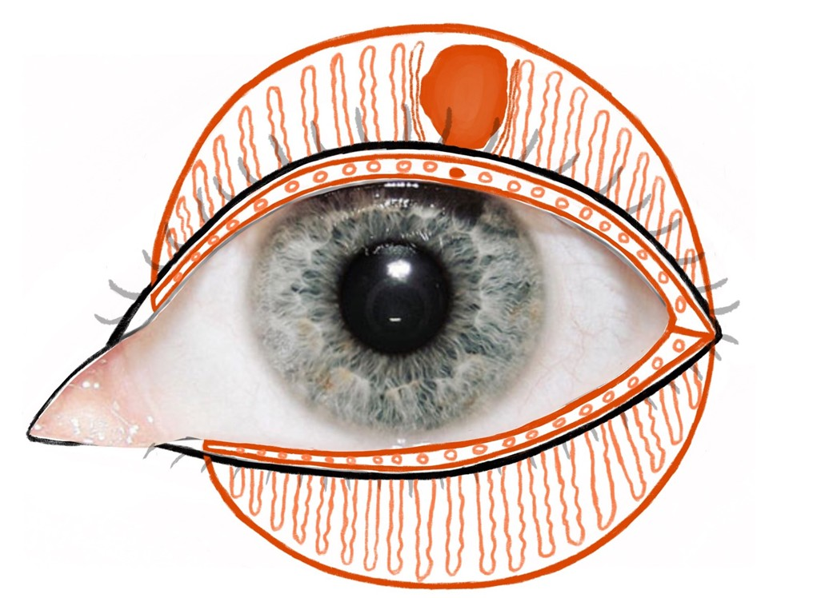
Drainage the purulent material
When:
after the abscess formation
How:
incision drainage the pus
Where
internal --vertical to the Lid Margin
External – parallel to the Lid Margin internal
Why
Internal avoid cutting across the glands
External--to minimize scar formation

Slide 23
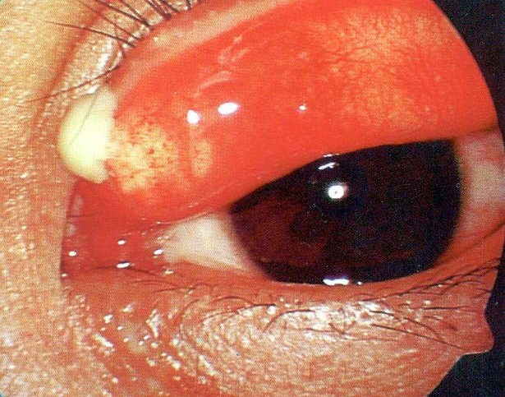
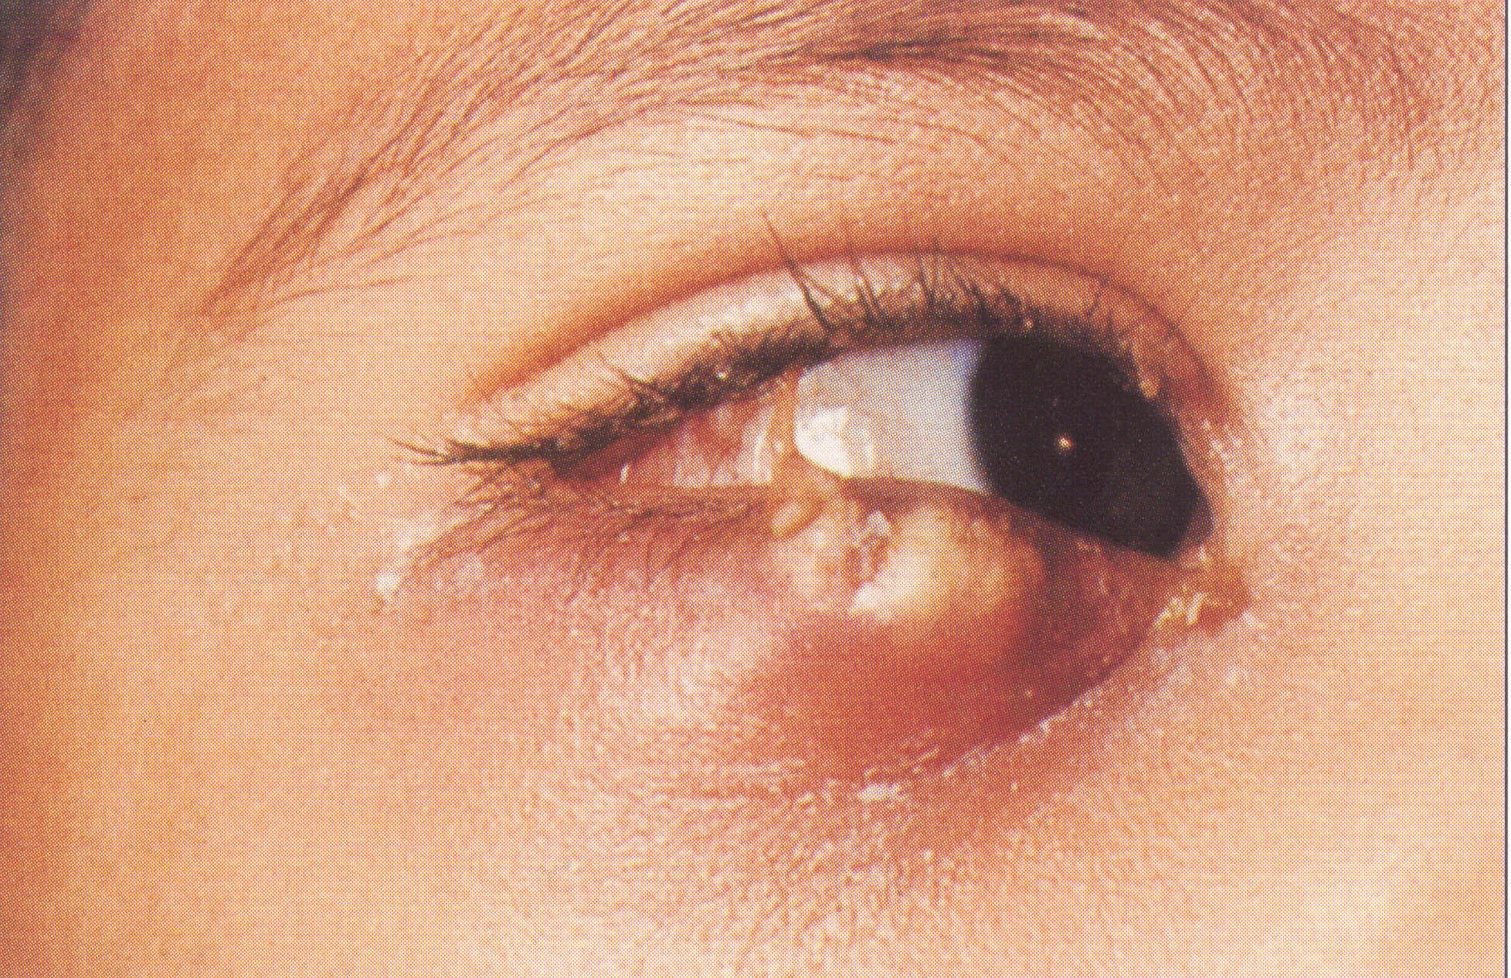


Hordeolum
Internal~ meibomian
+
+
++
conjunctiva vertical
External ~ Zeis’s , moll’s
+
++
+
skin horizontal
●Gland
●Redness
●Swelling
●Pain
●Point to
●incision

Slide 24
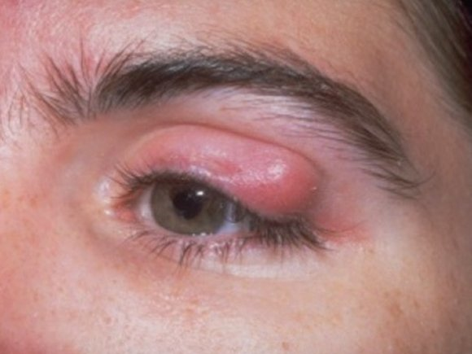
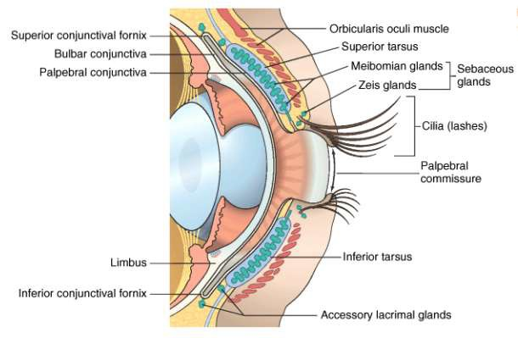
Chalazion(Meibomian cyst)
  is a chronic, sterile, granulomatous inflammatory lesion caused by retained sebaceous secretion leaking from the Meibomian or other sebaceous glands
  If chalazion secondarily infected is referred to as = INTERNAL HORDEOLUM

Slide 25
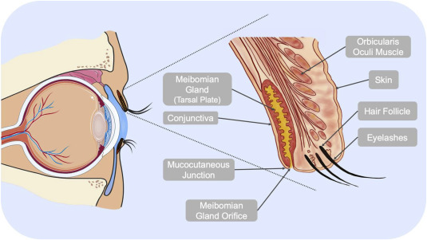
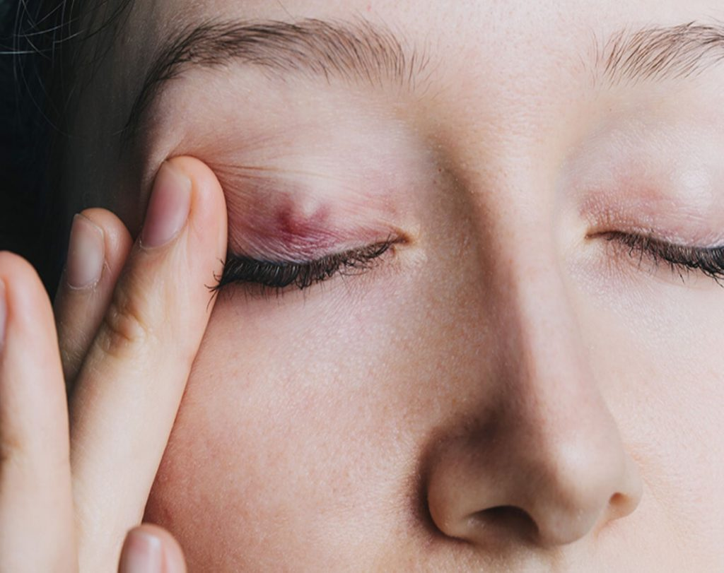
Etiology
Blockage of excretory ducts of tarsal glands
↓
The secretion in tarsal stimulates surrounding tissues
↓
Sterile granulomatous inflammation
Characteristics
Chronic:
Develops over weeks
Absence of acute inflammation signs
Sterile :
no abscess formation
Granulomatous:
Similar to tubercle but without formation of caseous necrosis

Slide 26


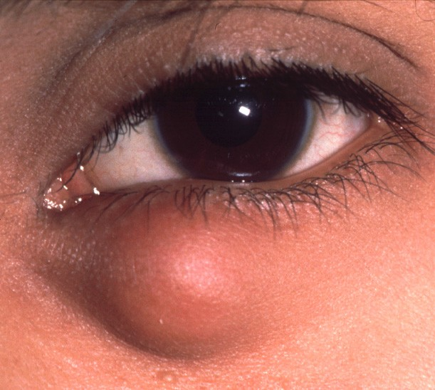
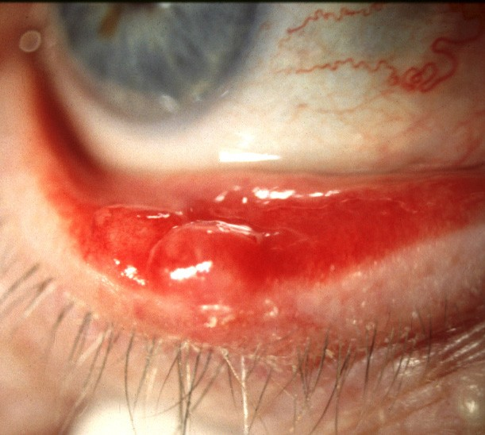
Signs of chalazion (Meibomian cyst)
Painless, roundish, firm lesion within tarsal plate
May rupture through conjunctiva and cause granuloma

Slide 27
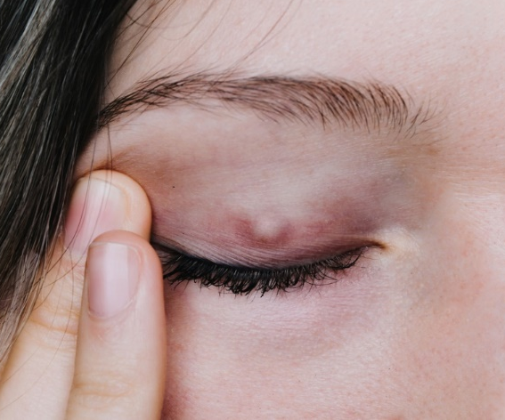
Symptoms
Painless localized swelling
Foreign body sensation
Usually appeared in juvenile and adult

Slide 28
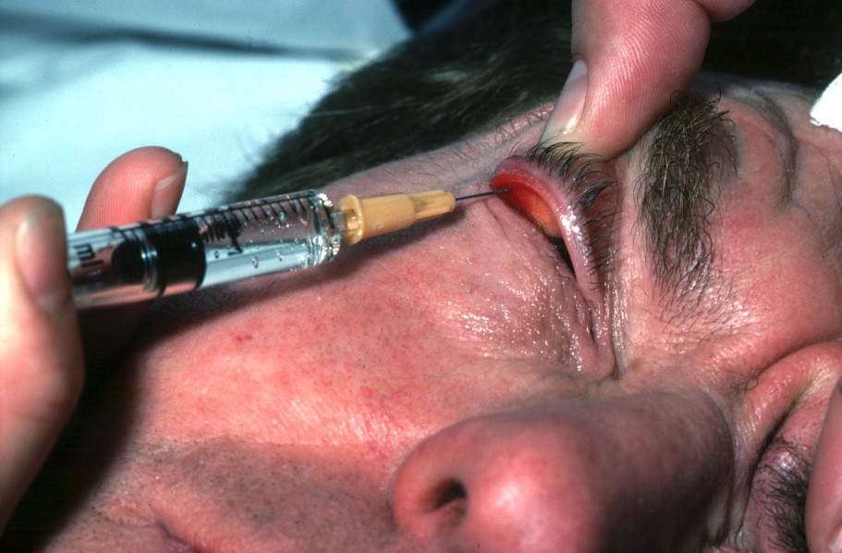
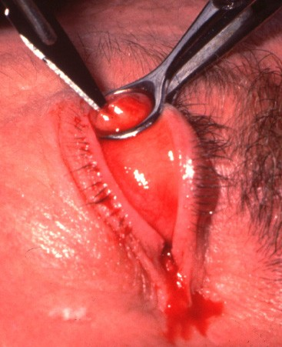
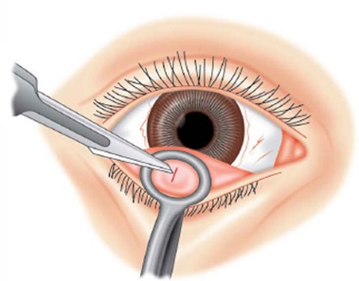
Treatment
Spontaneous Resolution
Oral Azithromycin may be required as prophylaxis in patients with recurrent chalazia, particularly if associated with acne rosacea
Intralesional steroid injection if it is near punctum
Surgery :incision and curette [Vertical incision into the tarsal gland ]
Injection of local anaesthetic
Vertical incision & curettage
Recurrent case in old patient = need biopsy

Slide 29
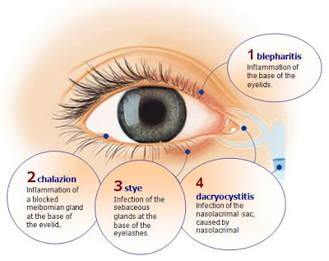

Slide 30
Anatomic deformities
Entropion
Ectropion
Lagophthalmos
Blepharospasm
Ptosis

Slide 31
QUESTIONS
WHAT’S THE NORMAL POSITION OF THE EYELIDS?
HOW TO KEEP THE NORMAL POSITION OF THE LIDS?

Slide 32
How to keep the correct position?
Muscle
Orbicularis oculi muscle --close Levator --open
Lower eyelid retractor --open
Nerve
Facial nerve oculomotor nerve

Slide 33
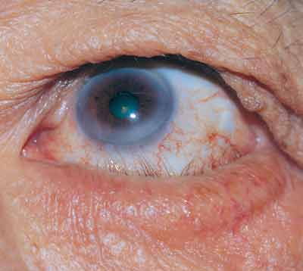
Entropion
The lid margin rolls to the eye globe
mainly affecting lower lid leads to rubbing on the cornea cause
  Irritation,
  Corneal epithelial erosions
  Ulceration
Causes:
  Involutional (spastic, senile)
  Cicatricial (Trachoma, Trauma, Chemical injuries)
  Congenital
Treatment
  Soft Contact lens
  Surgery (Tarsotomy)

Slide 34
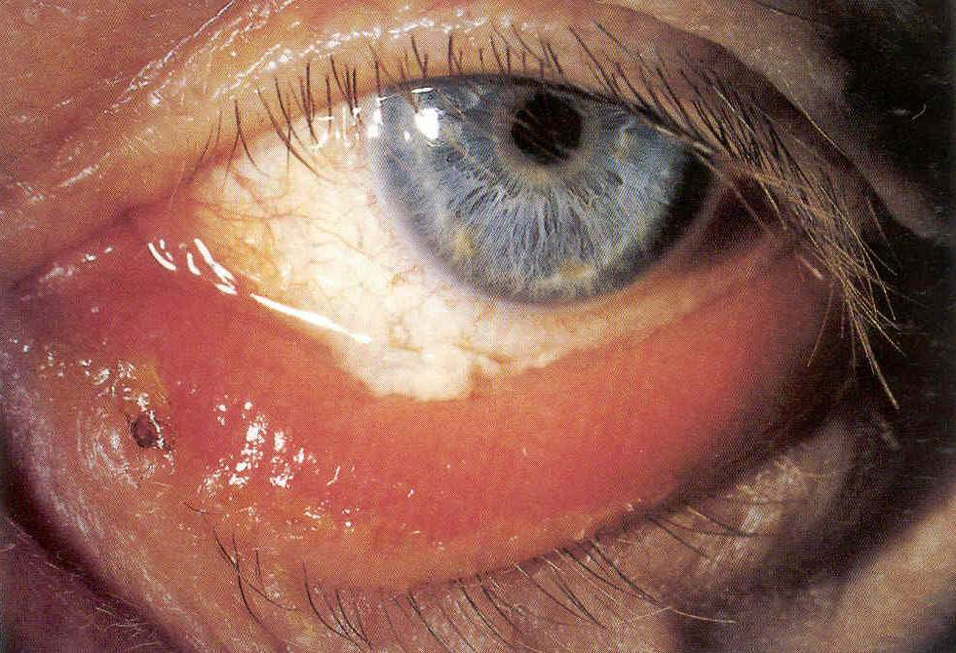
Ectropion
The lid margin turns away from the globe Causes:
Relaxation of the orbicularis oculi muscle Senile ( facial nerve palsy)
Cicatricial ( Burn)
Congenital

Slide 35
Ptosis (Blepharoptosis)
Greek word = ACT OF FALLING
Abnormal drooping of the upper eyelid.
Normally, upper lid covers about upper one-sixth of the cornea i.e., about 2 mm.
In ptosis it covers more than 2 mm.

Slide 36
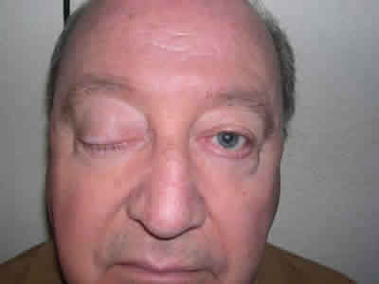
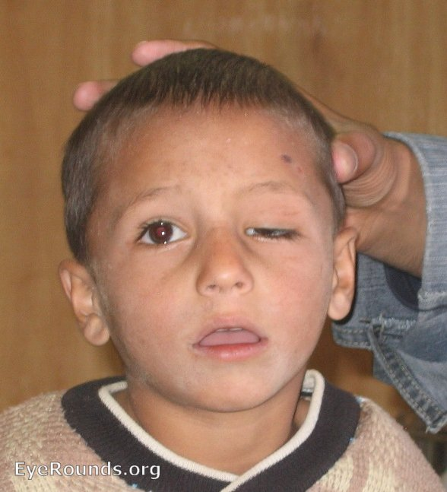
Ptosis (Blepharoptosis)
An abnormally low position of the upper lid
  Congenital
  Acquired
    Neurogenic :
      Third nerve paresis
      Horner syndrome
    Myogenic :
      Myasthenia gravis
    Mechanical :
      Mass
      Scarring

Slide 37
Congenital blepharoptosis
Autosomal dominant or recessive inheritance
Congenital weakness (maldevelopment) of Levator Palpebrae Superioris (LPS) +/- Superior Rectus Muscle

Slide 38
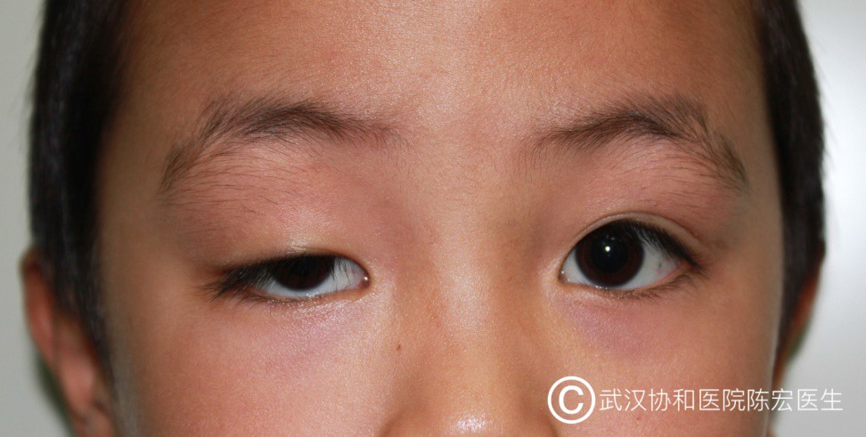
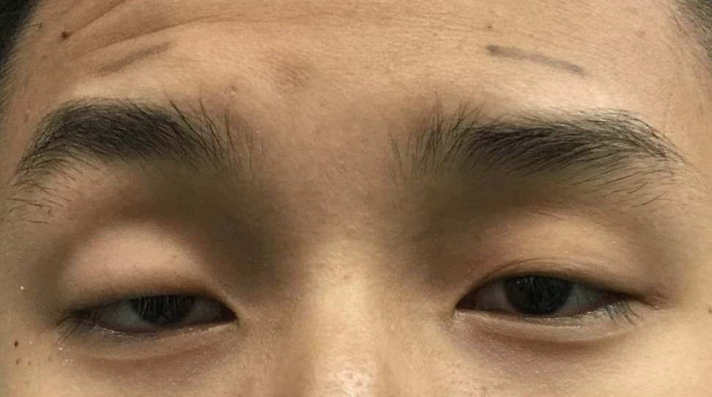
Clinic Findings
The upper eyelid cannot be elevated and cover part ot the cornea and pupil
Face even jaw upward in order to see clearly
Marked wrinkles in forehead due to the frantalis muscle works
Binocular asymmetry
Visual disturbance
ྎ࿥ܐ޾܅ᴺ፲ᑀᴯਡ

Slide 39
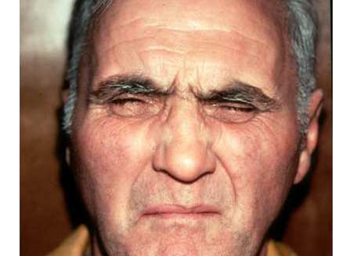
Blepharospasm
involuntary Orbicularis muscle spasm and contraction
involuntary, sustained and forceful closure of the eyelids.
Tx = botulinum type A toxin injections (Botox)

Slide 40
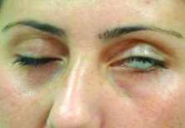
Lagophthalmos
Incomplete closure of the palpebral aperture when attempt is made to close the eyes
Cause: Facial Nerve Palsy

Slide 41
Tumors of the lids
CLASSIFICATION
BENIGN TUMORS
1. Papillomas
2. Xanthelasma
3. Haemangioma
4. Neurofibroma (von Recklinghausen’s disease).
MALIGNANT TUMOURS
1. Basal-cell Carcinoma
2. Squamous cell Carcinoma
3. Sebaceous Gland Carcinoma
4. Malignant Melanoma

Slide 42
Benign tumors

Slide 43
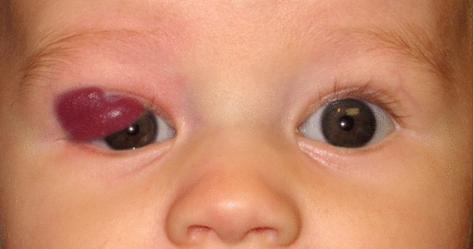
Hemangioma
Arise at or shortly after birth
involute spontaneously by age 7 years
Anisometropia, Amblyopia
Strawberry nevus

Slide 44
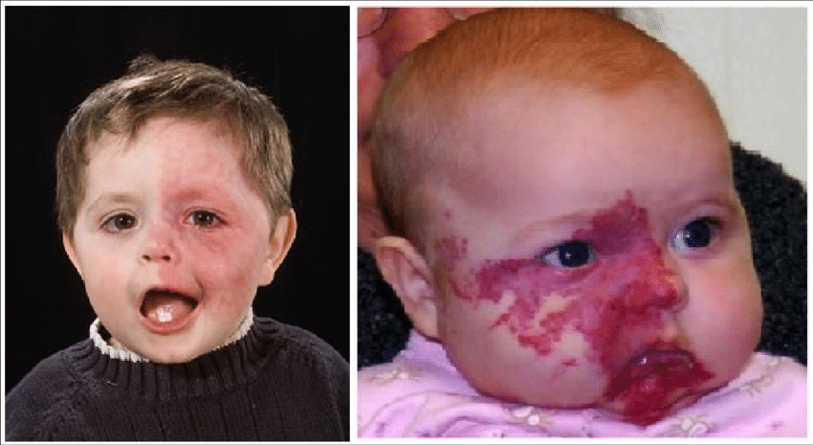

Sturge-weber syndrome
Port –wine stain birthmark covers one side of face
Glaucoma
Nervous system problems

Slide 45
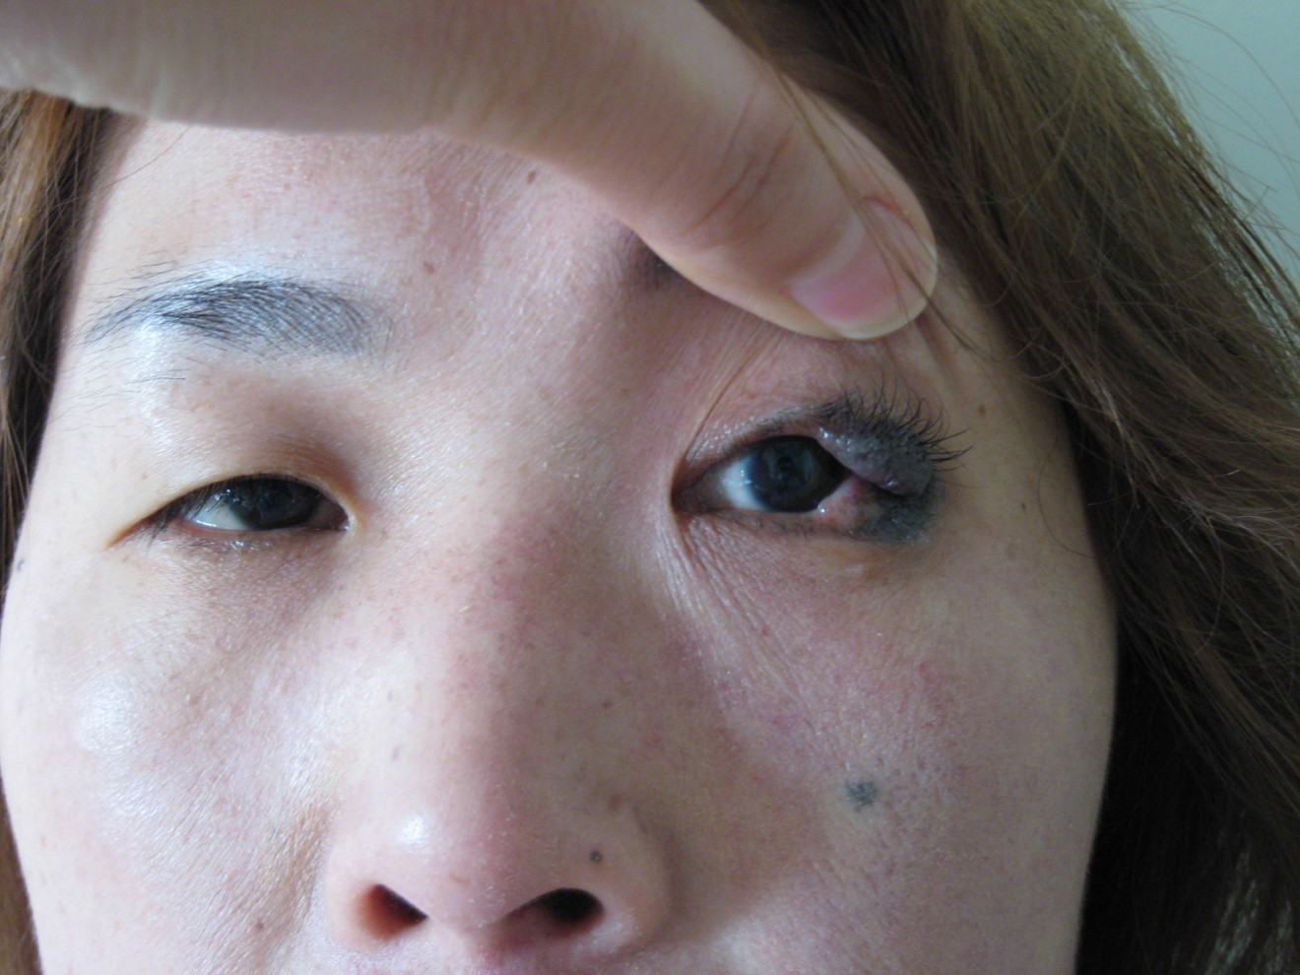
Nevus of the eyelid
ྎ࿥ܐ޾܅ᴺ፲ᑀᴯਡ

Slide 46
Papillomas

Slide 47
XANTHELASMA

Slide 48
CAPILLARY HAEMANGIOMA

Slide 49
Malignant tumors

Slide 50
BASAL-CELL CARCINOMA

Slide 51
SQUAMOUS CELL CARCINOMA

Slide 52
MALIGNANT MELANOMA

Slide 53
Thank You

